Slide 1

Akrivia Health / Global Minds Proteomics Update
Julie Segueni, PhD, Bioinformatics
Kevin Blighe, PhD, Bioinformatics
Corey Oravetz, CSM, Project Manager​
Shahraz Niwaz, MSc , Business Account Manager
2026-Mar-31

Slide 2
Agenda
Action Items
Bio Updates
Open Q&A / Discussion
Timeline / Gantt
Month 2026
00

Slide 3
Meeting Minutes & Action Items

Slide 4
Action Items
Action Items from 2026-Mar-17 Meeting
Joe: Circle back and confirm that sharing subject IDs from the Akrivia database without other associated data is approved by the broader group. - IN PROGRESS
Julie: Ask Kevin about age correction in the previous analysis and obtain the relevant slides - Julie: Create protein abundance heat maps for proteins within enriched pathways from the rich plots. - COMPLETED (NO ACCESS TO FILES OR CODE)
Julie: Provide a more direct comparison of the effect of age adjustment on the pathways. - IN PROGRESS
Julie: Create a heat map showing average protein expression per diagnosis (bipolar disorder, dementia, depressive disorder, psychotic disorder) for the DA proteins. - COMPLETED
Action Items from 2026-Mar-10 Meeting
Julie: Extract proteins within the ridge plot peaks and plot them on raw abundance heatmaps. - COMPLETED
Action Items from 2026-Feb-10 Meeting
Joe: Provide Julie with any details about the normalization process that was applied to one of the data files - IN PROGRESS
Joe: Check on the progress of clinical data analysis and share any relevant co-morbidities or self-reported information that might be useful for differential analysis in next week's meeting – IN PROGRESS

Slide 5
Bio Updates

Slide 6
Updated DA results
DA analysis results – General results
11k SOMAid from Somascan panel (mapping to 9,535 unique genes)
DA analysis per contrast among the diagnostic classes, adj.pval <=0.05 and |logFC| >= 0.5
After covariate analysis using age
Contrast | Dementia (n = 124 patients) | Depressive disorder (n = 157 patients) | Psychotic disorder (n = 38 patients) | Schizophrenic disorder (n = 54 patients)
Bipolar disorder (n = 81 patients) | 26 DA proteins | 0 DA protein | 0 DA protein | 0 DA protein
Dementia (n = 124 patients) |  | 23 DA proteins | 0 DA protein | 46 DA proteins
Depressive disorder (n = 157 patients) |  |  | 5 DA proteins | 0 DA protein
Psychotic disorder (n = 38 patients) |  |  |  | 0 DA protein

Slide 7
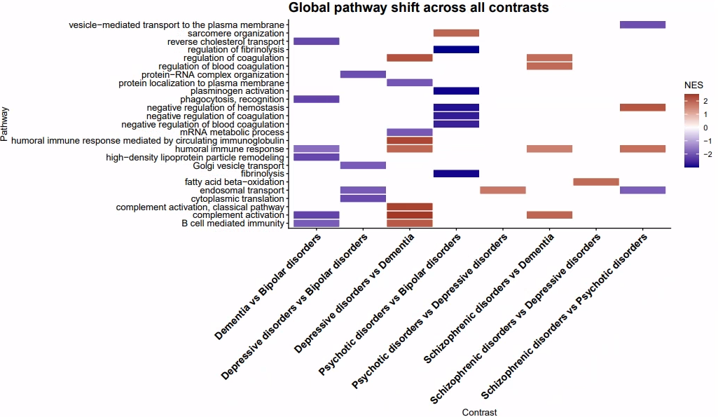
Global pathway analysis results after covariate analysis

Slide 8
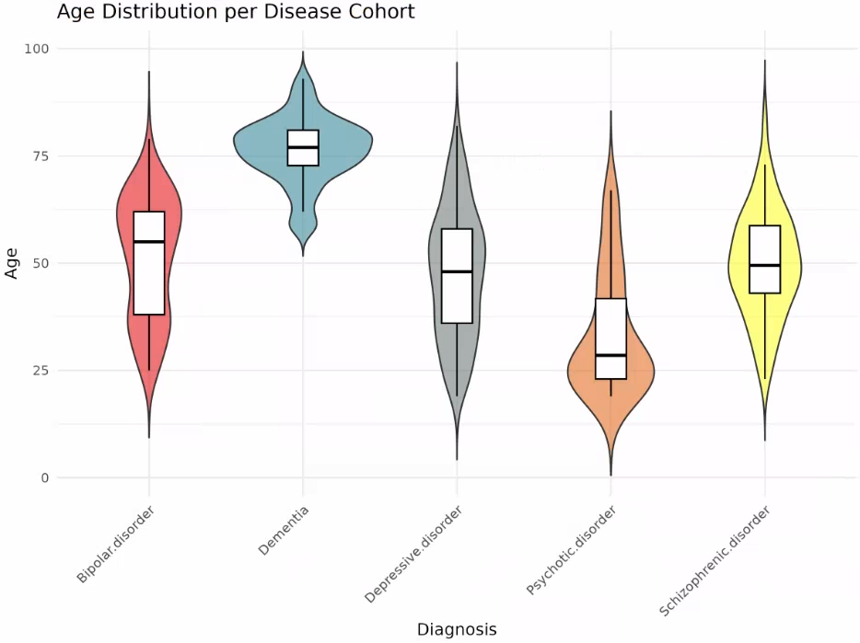
Age distribution across diseases
Age is significantly different between our cohorts, we may not want to use it as a covariate.

Slide 9
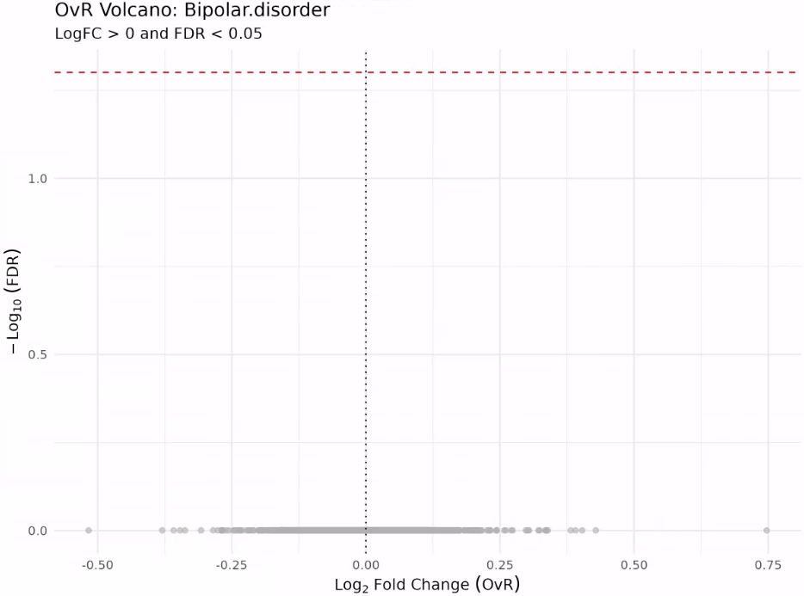
Updated DA results
DA analysis results – OvR not contrast-based
Using only adj p value threshold at 0.05

Slide 10
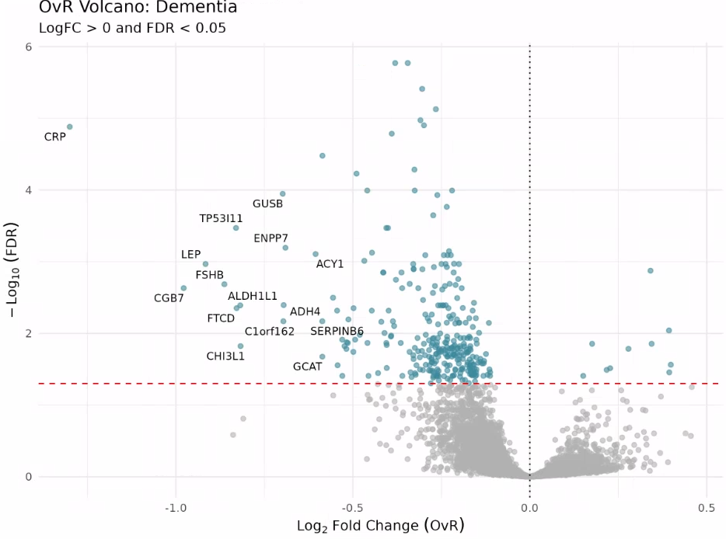
Updated DA results
DA analysis results – OvR not contrast-based
Using only adj p value threshold at 0.05

Slide 11
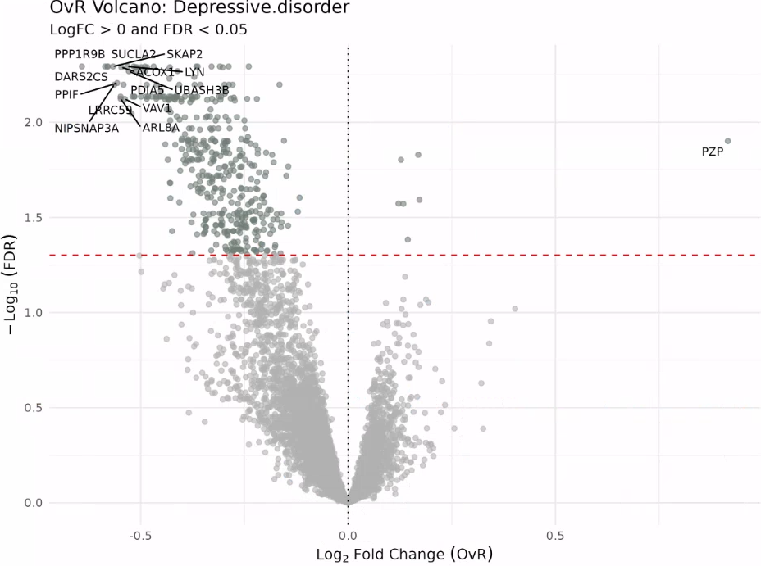
Updated DA results
DA analysis results – OvR not contrast-based
Using only adj p value threshold at 0.05

Slide 12
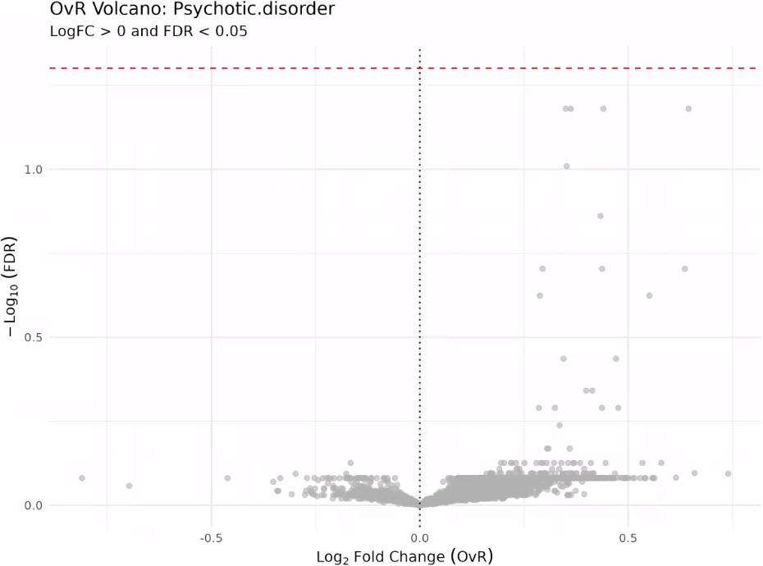
Updated DA results
DA analysis results – OvR not contrast-based
Using only adj p value threshold at 0.05

Slide 13
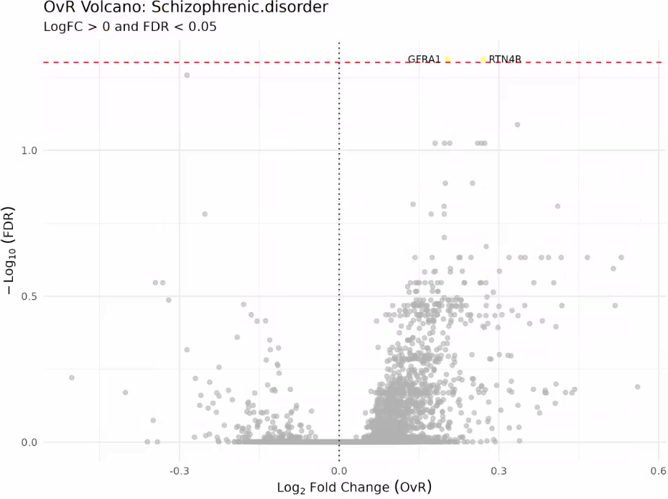
Updated DA results
DA analysis results – OvR not contrast-based
Using only adj p value threshold at 0.05

Slide 14
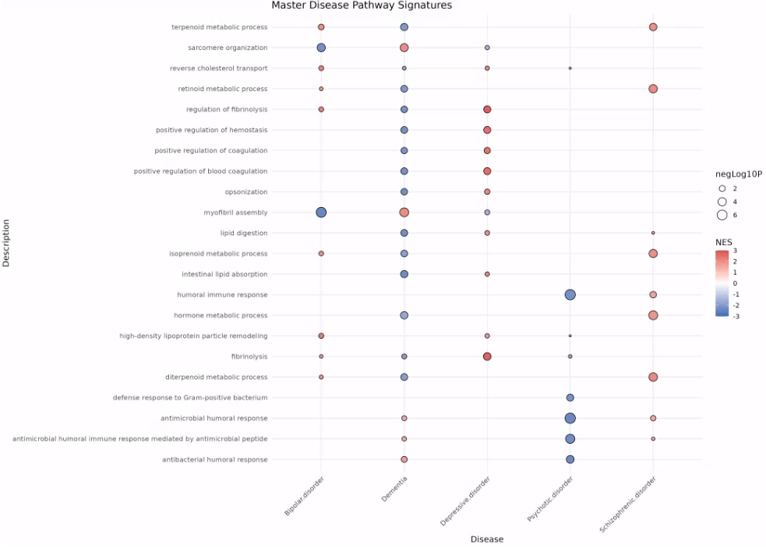
Pathway analysis across 5 diseases
We identified disease-specific pathways.

Slide 15
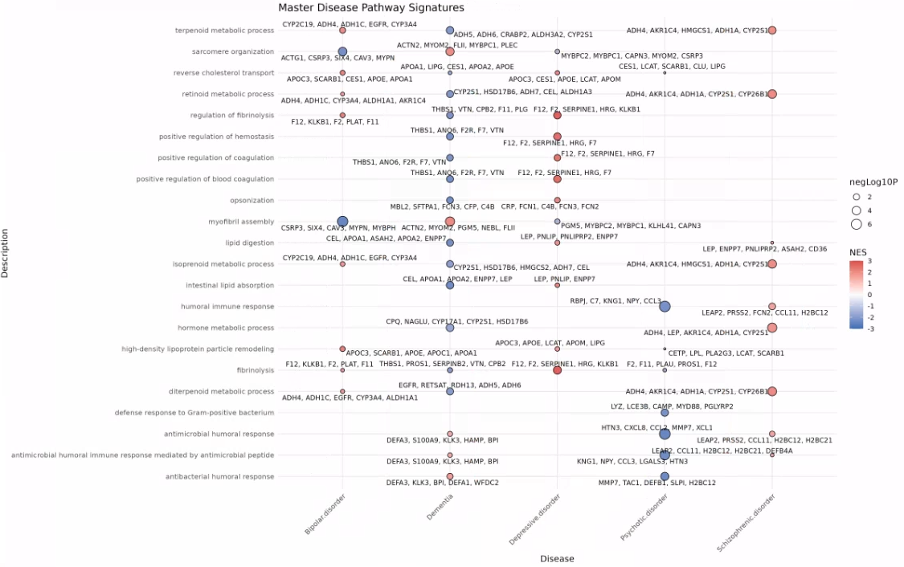
Pathway analysis across 5 diseases
We identified disease-specific pathways, based on driving proteins shown here.

Slide 16
Timeline & Deliverables

Slide 17
J&J: Akrivia Health SomaLogic Proteomics Analysis
Timeline
Today
2026
Feb
Mar
Apr
Feb 3 - Feb 9
5 days
Onboarding, Environment Setup, Data Import into Domino
2026
Feb 10 - Feb 13
4 days
Data Normalization & QC
Global Minds / Akrivia Proteomics Analysis
Feb 16 - Feb 23
6 days
Diff Abundance Analysis (DAA)
Feb 24 - Mar 30
Pathway Analysis + Variance Partitioning Analysis + Rework
25 days
Mar 31 - Apr 13
Compare Treatment-Resistant Patients vs Reponders
10 days
Correlate Proteomics Levels to Clinical Data
10 days
Apr 14 - Apr 27
Apr 28 - Apr 29
Reporting & QC
2 days
Timeline
On-Boarding (4 hours)
Data Retrieval, Normalization, & QC (16 hours)
Differential Abundance Analysis (DAA) (24 hours)
Pathway Analysis (24 hours)
Compare treatment-resistant patients vs responders (16 hours)
Correlate proteomics levels to clinical data (12 hours)
Reporting & QC (8 hours)
Total: 104 hours Bioinformatics; 10 hours Project Management.
Pause additional comparisons/correlations until Akrivia Clinical Data is available?

Slide 18
Archive

Slide 19
Action Items
Action Items from 2026-Mar-10 Meeting
Julie: Redo DA analysis and Pathway analysis using Age as covariate – COMPLETED, 2026-Mar-17
Julie: Color the volcano plot by identified pathway membership to show distribution of effect sizes per pathway. - COMPLETED, 2026-Mar-17
Julie: Provide new plots showing raw pathway-level abundances using dementia as a reference group across all diseases. - COMPLETED, 2026-Mar-17
Joe: Check-in with Alessandra that the budget and spend are acceptable if the project timeline extends. - COMPLETED, 2026-Mar-17
Action Items from 2026-Feb-24 Meeting
Julie: Pathway analysis from DAA results – COMPLETED, 2026-Mar-09
Action Items from 2026-Mar-17 Meeting
Julie: Julie to consider further analysis during the DAA that can statistically validate the absence of bias effects - COMPLETED, 2026-Mar-17
Julie: Start on the DAA process – COMPLETED, 2026-Feb-23
Action Items from 2026-Feb-10 Meeting
Joe: Joe to reach out to Akrivia to get clarification about the 17 samples labeled as 'other' - COMPLETED, 2026-Mar-17
Julie: Start on the QC and normalization process – COMPLETED, 2026-Feb-13

Slide 20
Action Items
Action Items from 2026-Feb-03 Meeting
Joe: Provide access to the MS Teams folder with the clinical XLS files – COMPLETED, 2026-Feb-06
Farzad: Create a new Domino project and upload the proteomics data files for the analysis – COMPLETED, 2026-Feb-03
Corey: Setup weekly calendar cadence for the team to meet – COMPLETE, 2026-Feb-03

